Slide 1

CONFIGURATION SERVER

Slide 2

Agenda
the problem
SOLUTION
Hands-on

Slide 3

1
the problem

Slide 4



Managing configurations for each micro service separately can become tedious and time consuming
How can we optimize the process?
With the current approach of separate properties file the application must be restarted to fetch the latest changes
We usually have multiple environments (dev,stage,prod) -> Profiles for the Win?
The biggest problem is that properties file are tightly coupled to the code base
Notes:
Data slide (version 5)
Tables are mostly used to show the cost of the project.
If the table is not too extensive, as shown here, use elements to reinforce or remind the audience of key ideas or information.

Slide 5
We need a technology to maintain all properties and if any properties are changed it should be reflected in the applications without restarting the application
Notes:
Data slide (version 5)
Tables are mostly used to show the cost of the project.
If the table is not too extensive, as shown here, use elements to reinforce or remind the audience of key ideas or information.

Slide 6
1
Solution

Slide 7
Main components
Configuration Server
Config
server
Configuration Client
microsoft.com

Slide 8
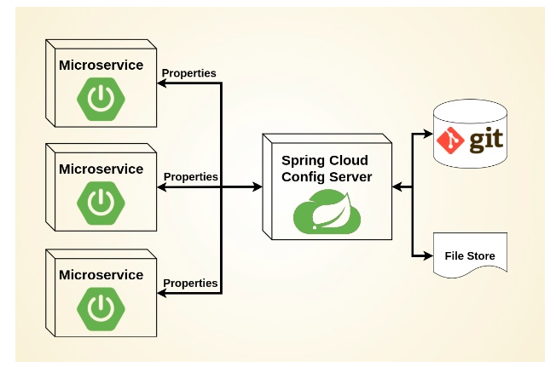
Configuration Server
solution

Slide 9
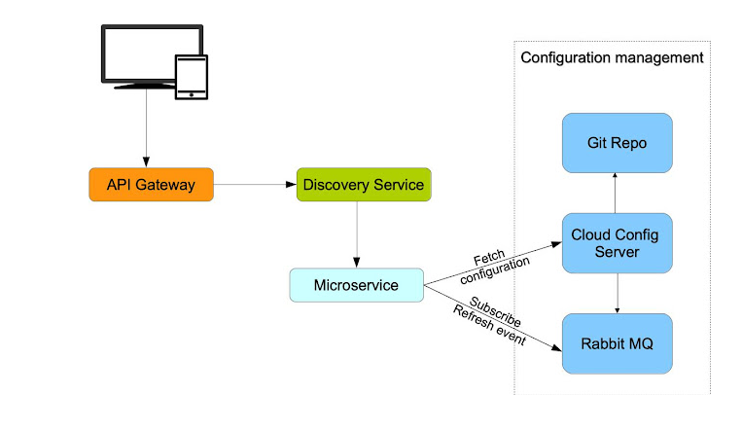
Config
server
microsoft.com

Slide 10
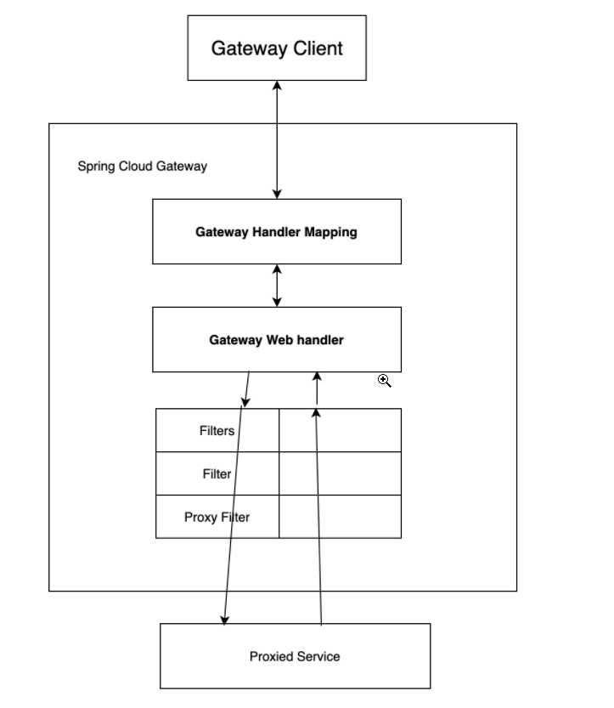
Spring config server

Slide 11
1
Hands-on

